Slide 1
Minnesota PowerShell Automation Group
March 2018

Slide 2
PowerShell Core 6
An Introduction to the go forward PowerShell version

Slide 3
5 things to know
Open Source
  https://github.com/PowerShell/PowerShell
Runs side-by-side with Windows PowerShell on Windows machines
There are breaking changes in PowerShell from Windows PowerShell
Executable renamed
  Now pwsh.exe, default install at C:\Program Files\PowerShell
Backwards compatibility with Windows PowerShell
Notes:
GA release, https://blogs.msdn.microsoft.com/powershell/2018/01/10/powershell-core-6-0-generally-available-ga-and-supported/
What’s new in PowerShell Core 6, https://docs.microsoft.com/en-us/powershell/scripting/whats-new/what-s-new-in-powershell-core-60?view=powershell-6
Breaking changes, https://github.com/PowerShell/PowerShell/blob/master/docs/BREAKINGCHANGES.md

Slide 4
It all starts with .NET
Requires .NET core 2.0 runtime
.NET core 2.0 is a .NET platform that implements the .NET Standard 2.0
  .NET standard 2.0 is a set of set of APIs that all .NET platforms must support. This unifies .NET platforms and prevents future fragmentation
.NET Framework 4.6.2 fully supports .NET standard 2.0
Windows 10 Fall Creators update contains .NET Framework 4.7.1, it supports .NET standard 2.0.
  .NET Framework cannot be removed from Windows 10
Notes:
.NET standard FAQ: https://github.com/dotnet/standard/blob/master/docs/faq.md
.NET Framework 4.7.1: https://blogs.msdn.microsoft.com/dotnet/2017/10/17/announcing-the-net-framework-4-7-1/

Slide 5
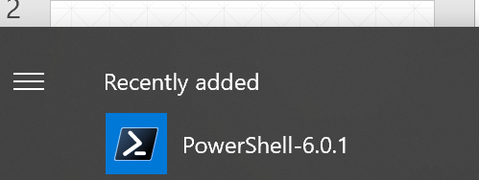
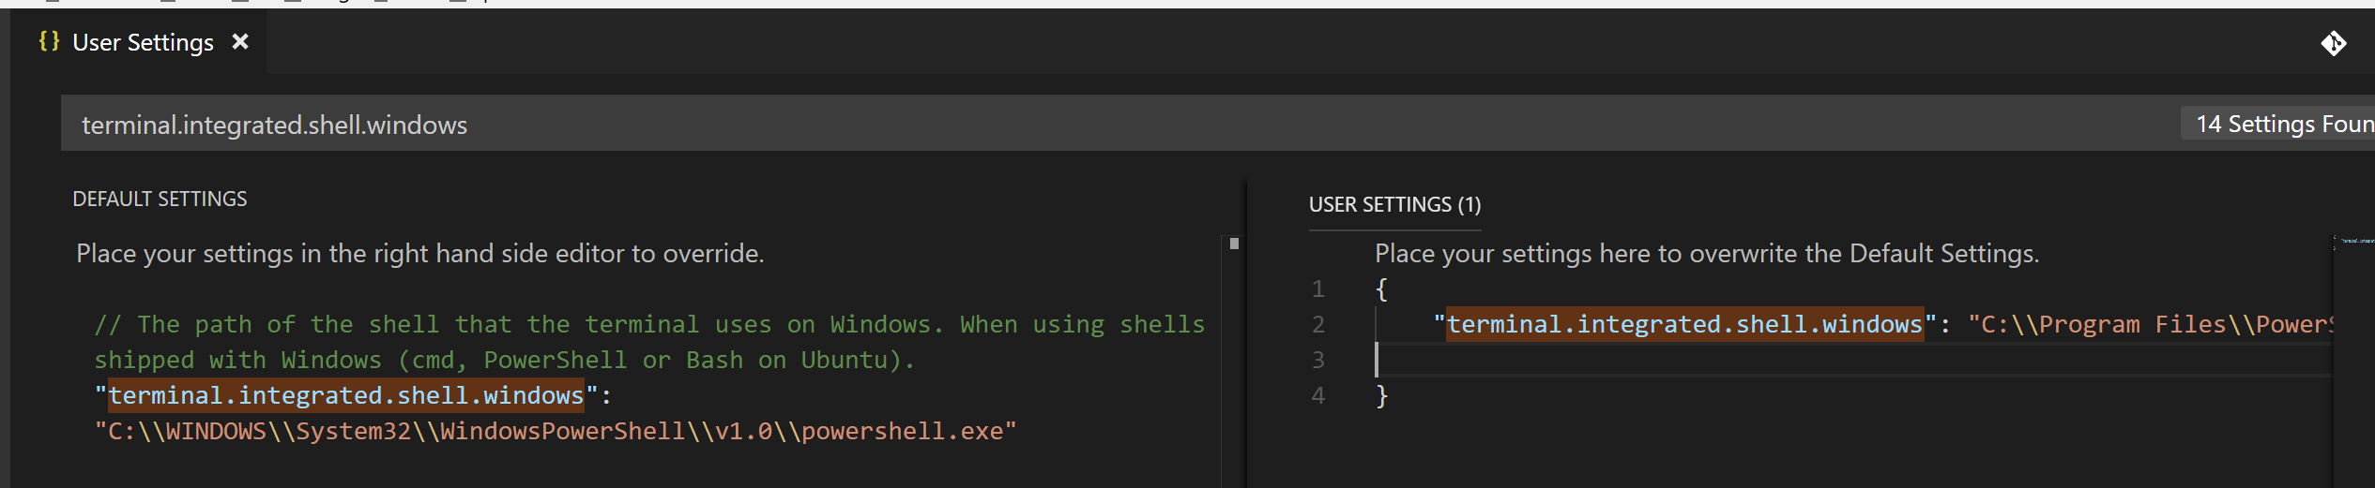
First Steps on Windows
Launch PowerShell as an Administrator
Run Update-Help
  You always want the latest help
Setup Visual Studio code to use PowerShell as your terminal
Notes:
To set visual studio code terminal default as PowerShell core. Go to Settings > Seach the json file for terminal.integrated.shell.windows > on the right hand frame for user overrides copy the current setting from the default into the user override replacing the path with the path to the pswh.exe you installed, ensuring double forward slashes are used in the path.

Slide 6
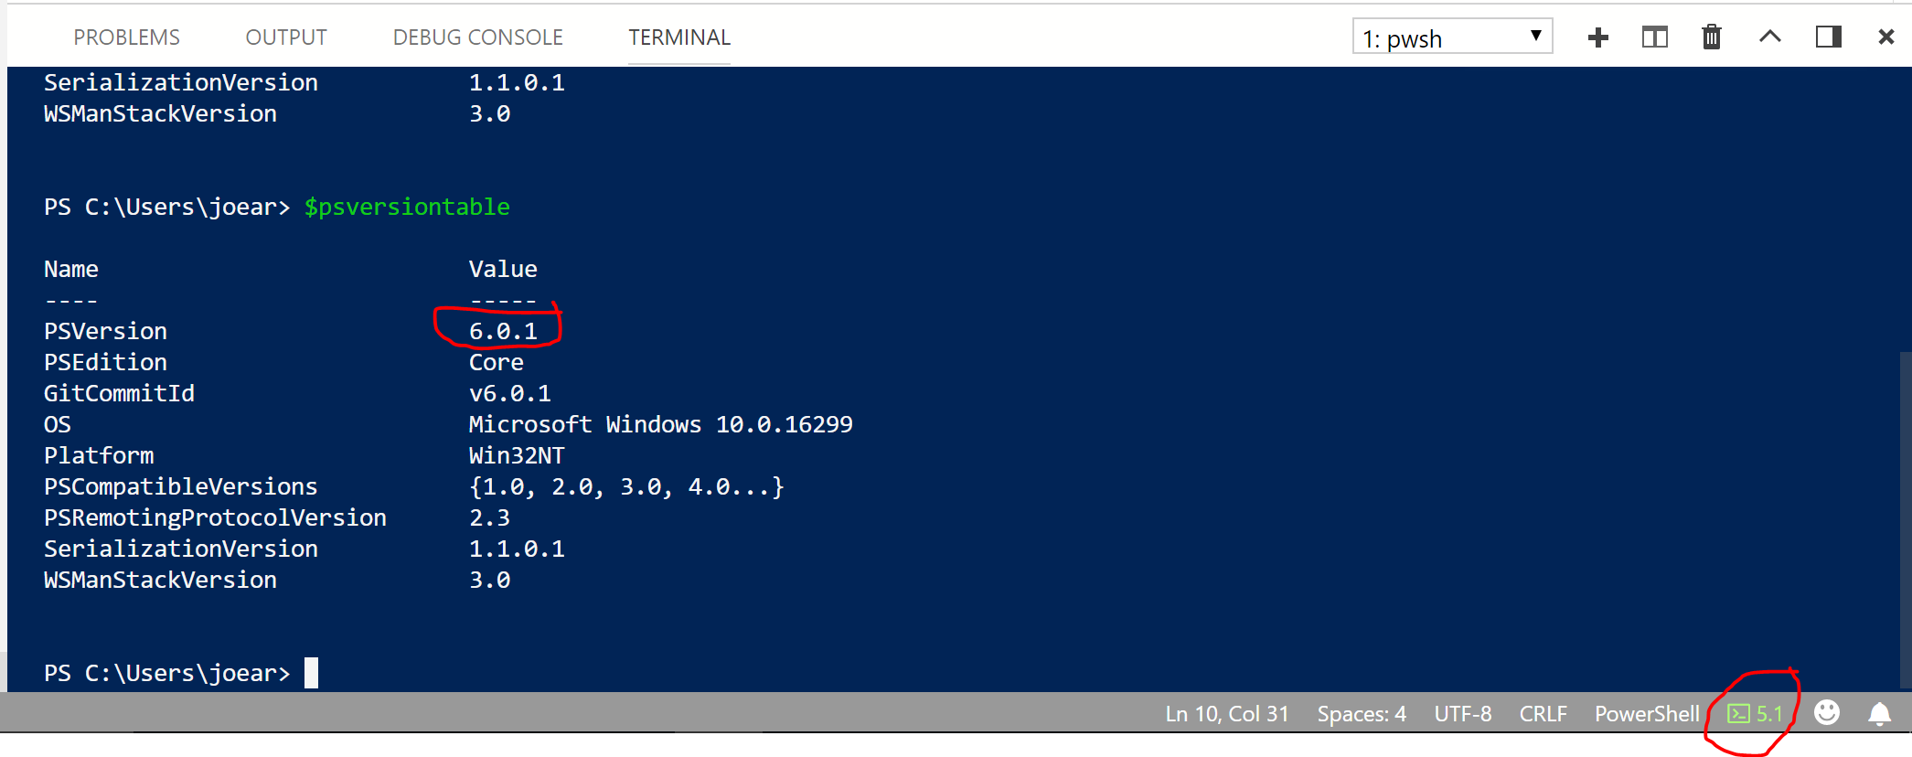
More on Visual Studio Code
Ensure you’re running in a PowerShell Core 6 session.
Notes:
Ensure you’re running in the PowerShell 6 session. If you relaunch Code after setting the default terminal and don’t change your session to PowerShell 6 it will come back up in 5.1 (if running Windows 10). Once you set the session to 6.0 Code will remember your settings after restarting the app.
Note GitCommitID replaces BuildVersion in $psversiontable

Slide 7
Visual Studio Code demo
Notes:
This demo was run on a CentOS image on Hyper-v on my local laptop. The CentOS image was download from https://www.centos.org/download/. I ran both a GUI CentOS image and a WebServer CentOS image.

Slide 8
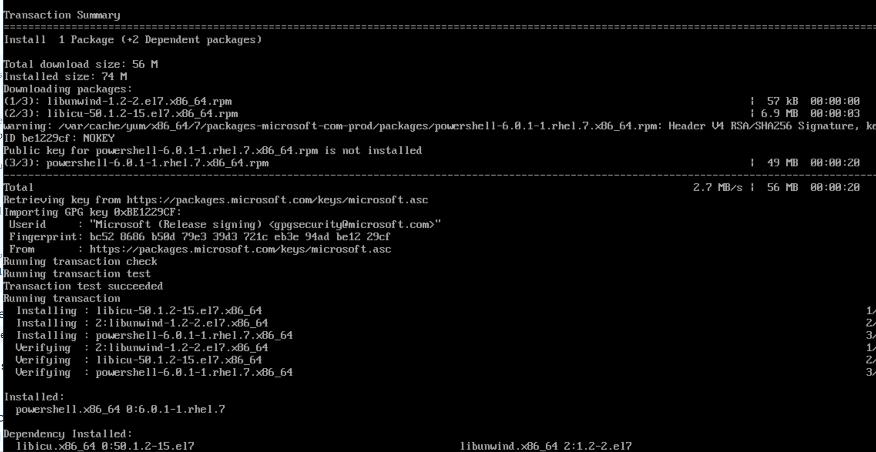
PowerShell on Linux
Register Microsoft repo
  as super user run the following command
    curl https://packages.microsoft.com/config/rhel/7/prod.repo > /etc/yum.repos.d/microsoft.repo
Install powershell and dependencies
  Sudo yum install –y powershell
Launch powershell
  pwsh
Notes:
Note: some older posts on installing powershell on linux show running the command ‘powershell’ to launch powershell. The current command to launch powershell is ‘pwsh’
Generally commands are in the usr/bin location (check your $path by running the command ‘printenv).
You can list install locations for a package by running ‘rpm –ql package-name’ replacing package-name with the actual package name.

Slide 9
PowerShell on Linux commandline

Slide 10
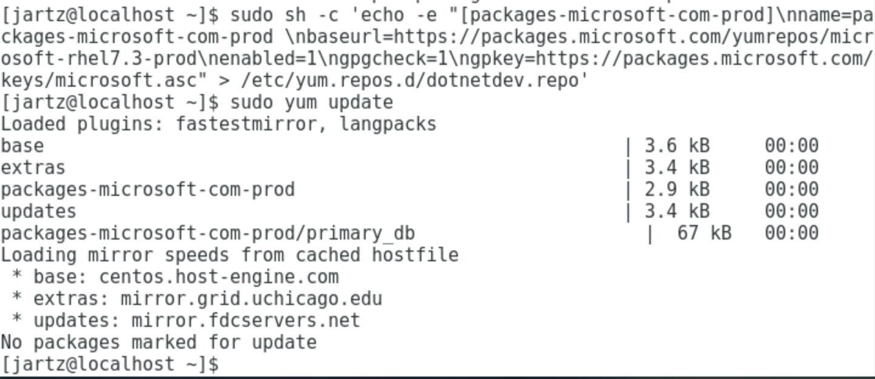
PowerShell Core 6 on Linux with .NET core
Operating system CentOS 7
  What I thought I needed
  Run ‘sudo yum update’ to ensure all packages are up to date
  Check to make sure all prerequisite packages are installed
  Register Microsoft Repo
Notes:
NOTE: this is part of my learnings, you don’t need to install .NET core for PowerShell core 6 to run. It installs the packages it needs when your do a yum install. I went through this as I believed that I needed to install .NET core as prerequisite. But, it may be helpful for those that need to install .NET core.
Installing .net Core on CentOS 7, https://docs.microsoft.com/en-us/dotnet/core/linux-prerequisites?tabs=netcore2x#install-net-core-for-centos-71-64-bit--oracle-linux-71-64-bit
Prerequisites to install .net core on CentOS, https://docs.microsoft.com/en-us/dotnet/core/linux-prerequisites?tabs=netcore2x#install-net-core-for-centos-71-64-bit--oracle-linux-71-64-bit
note: lttng-ust did not exist to install via yum install, all other packages are part of the CentOS GUI install

Slide 11
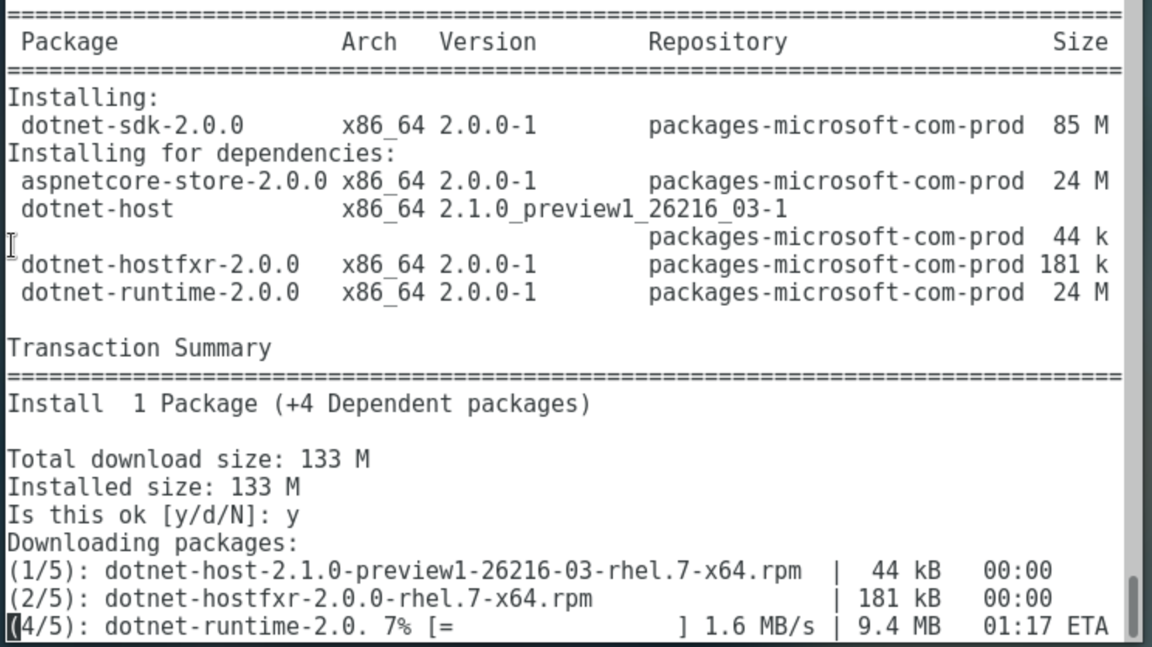
PowerShell Core 6 on Linux cont’d
Install .NET core

Slide 12
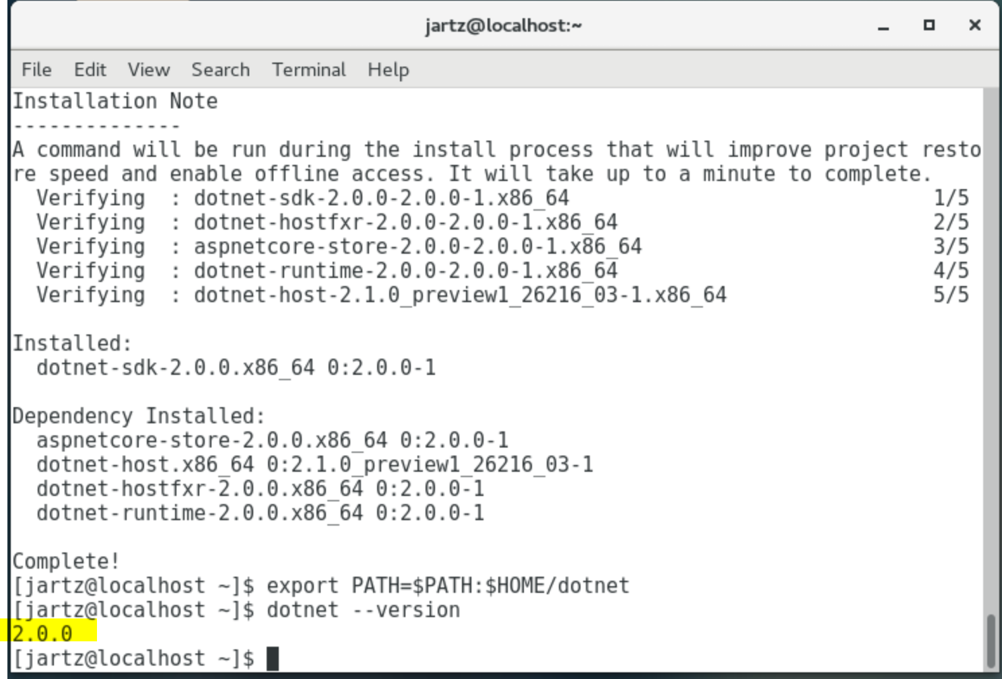
.NET core installed on Linux!
Validate install

Slide 13
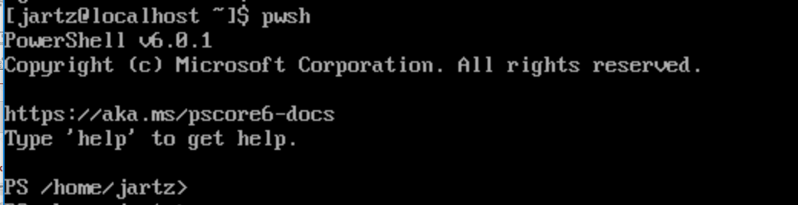
Install PowerShell Core 6 on Linux
.NET core is installed and the Microsoft package repo registered
Install powershell
  sudo yum install -y powershell
Launch powershell
  pwsh
Notes:
To install powershell run: sudo yum install -y powershell

Slide 14
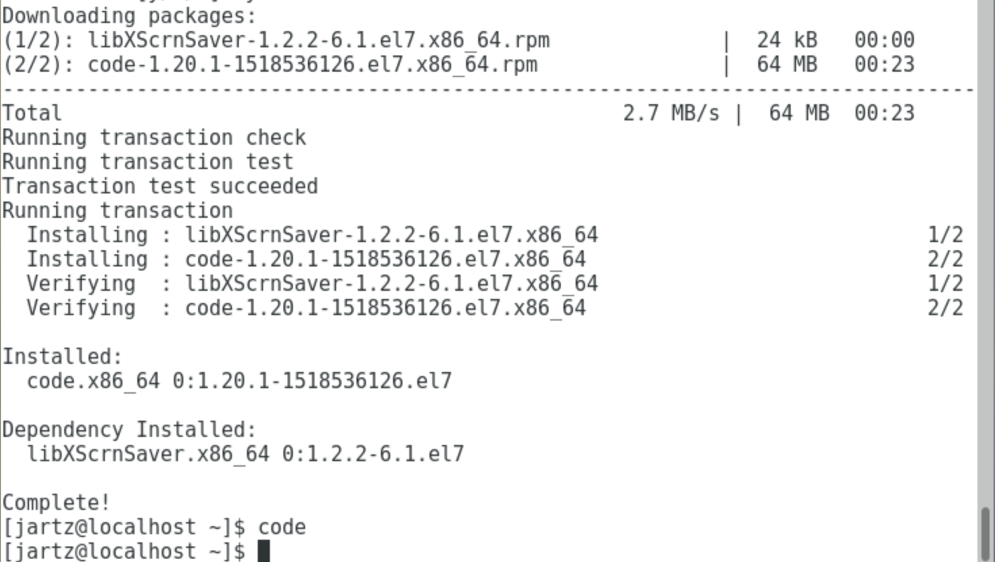
Install visual studio code
Import the keys
Register the repo
Install code
  Sudo yum install code
Launch code
  code
Notes:
Directions at https://code.visualstudio.com/docs/setup/linux
Must import keys, register the repo, and install code. Much like we did for PowerShell and .NET

Slide 15
Visual studio code customization
Install git
  Sudo yum install –y git
Install powershell module
  It’ll prompt you, or you can search for it
Like in Windows you can edit your users settings to point to install of powershell
  Install location: /bin/pwsh
Notes:
Review notes on slide 5

Slide 16
Visual Studio Code demo on Linux
Notes:
Demo visual studio code on the GUI CentOS 7 version running on Hyper-V.

